Slide 1
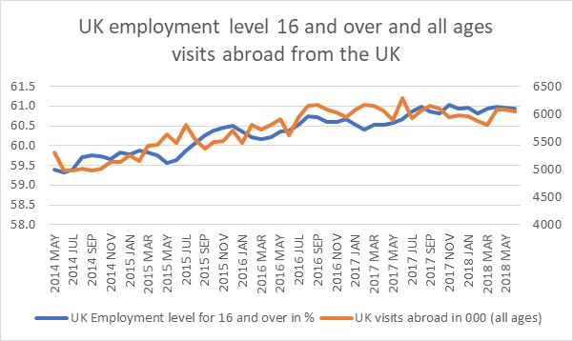
Linear Correlation and Regression Analysis
Linear Correlation Analysis?
Linear Regression Analysis?

Slide 2
Learning Objectives
On completing this unit, you should be able to:
Understand the meaning of simple linear correlation analysis.
Apply a scatter plot to visually represent a possible association between two data variables.
Calculate Pearson’s correlation coefficient for interval data and provide meaning to this value.
Calculate Spearman’s rank correlation coefficient for ordinal ranked data and provide meaning to this value.
Understand the meaning of simple linear regression analysis.
Fit a simple linear regression model to the two data variables.
Estimate the reliability of this model fit.
Solve problems using the Microsoft Excel and SPSS.

Slide 3
Linear Correlation Analysis
If we suspect that there is relationship between various sets of data, then our aims are to confirm that a relationship exists, and how strong it is. Even if we do not suspect the relationship, using the techniques from this chapter, we might discover that there is one. The techniques we will use are:
Scatter plots.
Pearson’s correlation coefficient (r) for interval data.
Spearman’s rank correlation coefficient (r_{s}) for ordinal ranked data.
Undertake an inference test on the value of the correlation coefficients (r and r_{s}) being significant (online only)

Slide 4
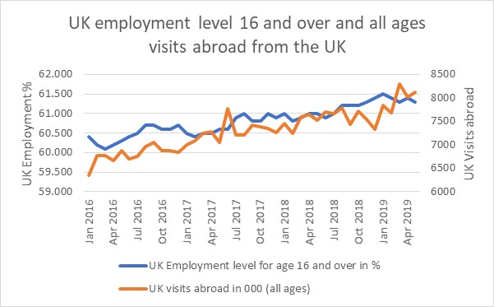
Scatter plots (1/3)
To introduce the concept of correlation, we need to start with scatter plots. The relationship between two variables is called their correlation. Scatter plots usually consist of a large body of data. The closer the data points come to making a straight line, when plotted, the higher the correlation between the two variables, or the stronger the relationship. Note that this line does not have to be straight, but in this case the relationship is non-linear, and we will not consider it in this chapter.

Slide 5
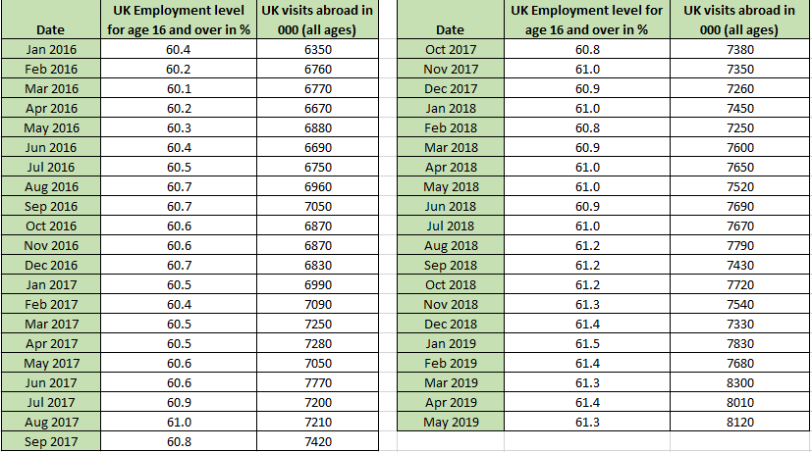
Scatter plots (2/3)
Example 9.1
Table 9.1 consists of two sets of data from the Office for National Statistics in the UK. Both data sets cover the period between January 2016 and May 2019. The first set shows monthly level of employment in the UK, in percentages, for the ages 16 and above. The second set shows monthly visits abroad, in thousands, for all ages of UK citizens in the same period.

Slide 6
Scatter plots (3/3)
By just looking at numbers, we can see that both data sets are increasing.
We can present these two data sets in a graph, and we use the graph with the left axis showing the scale for employment, and the right axis showing the scale for all UK visits abroad.
We can see both data sets flow with an upward trend from month to month, as the corresponding numbers show. We might speculate that if we knew the number of UK people 16 and over that are employed, we might be able to predict how many people will travel abroad from the UK.

Slide 7
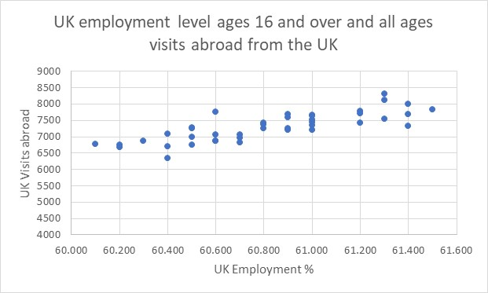
Scatter plots – Excel solution
Rather than showing the two data sets as line graphs, as in Figure 9.5, we could plot each pair of values as a point on a graph. This graph, shown in Figure 9.6, is called a scatter plot. How to construct the scatter plot using Excel has already been demonstrated in Chapter 1. We will therefore skip this part of explanation and concentrate on the content of the plot.
A scatterplot hints that there is some form of relationship; as the percentage of those that are not unemployed increases, there is a tendency for more people to travel abroad too. The data, therefore, would indicate a positive relationship. As we will show later, it is possible to describe this relationship by fitting a line or curve to the data set. This will enable us to predict the number of visits abroad based on any number of employed people between 16 and over.

Slide 8
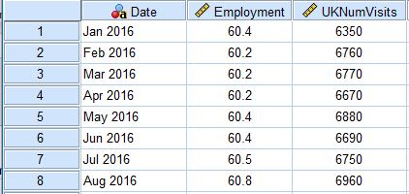
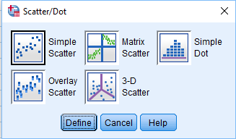
Scatter plots – SPSS solution (1/2)
SPSS data file: Chapter 9_Scatter plot.sav (only first 8 records illustrated below)
Graphs > Legacy Dialogs > Scatter/Dot
Choose Simple Scatter
Click Define

Slide 9
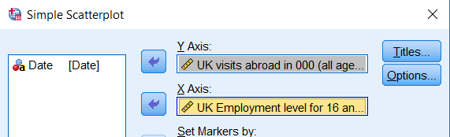
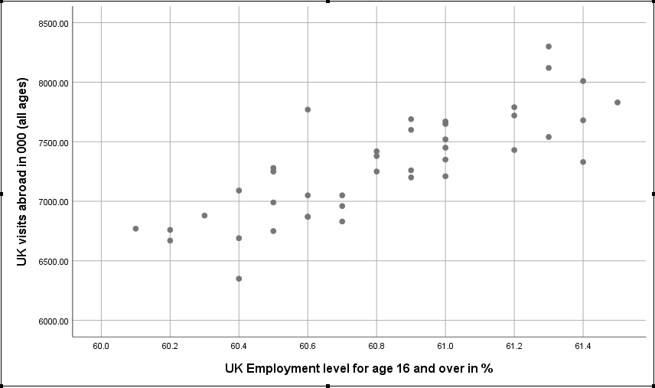
Scatter plots – SPSS solution (2/2)
We move number visited to Y Axis and employed to X Axis.
Click OK
SPSS Output

Slide 10
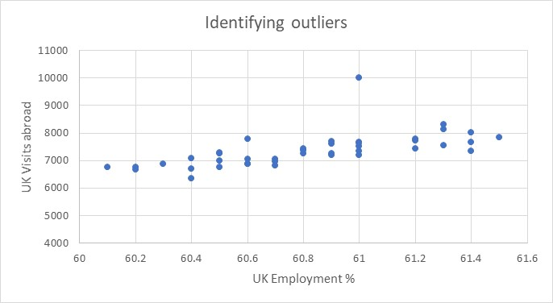
Scatter plots – Outliers
Let’s now conduct a little experiment. In Figure 9.11 we modified the y axis scale to run from 4000 to 11000 instead 4000 to 9000. More importantly, we also changed one point to illustrate the issue of outliers.
What are outliers? The scatter plot can be used to identify possible outliers within the data set. We can see in Figure 9.11 the same data set as in Figure 9.6 or 9.10, but with one data value of y changed (Jan 2018 = 10000, instead of 7450). This is far greater than any other data point for y values. This value is called an outlier. It could have been a data-entry error, or it could have been a genuine “freaky” number.

Slide 11


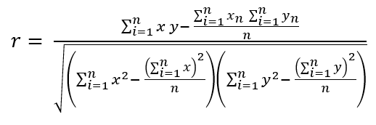
Pearson’s correlation coefficient, r (1/3)
The sample correlation coefficient that can be used to measure the strength of a linear relationship is called Pearson’s product moment correlation coefficient, r, defined by equation (9.2).
Where S_{x} is the sample standard deviation of sample variables x, S_{y} is the sample standard deviation of sample variables y, and S_{xy} is the sample covariance between variables x and y. If we substitute equation (9.1) into (9.2), we get an alternative equation representing Pearson’s correlation coefficient, which is often used. This is given by equation (9.3).
Alternative equation for r

Slide 12
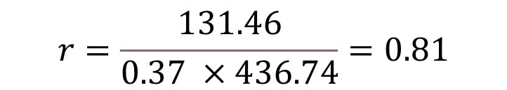
Pearson’s correlation coefficient, r (2/3)
Example 9.3
In Example 9.2 we already calculated the sample covariance as 131.46.
We have also calculated (not shown here) the standard deviations for x and y, and they are respectively s_{x}=0.37 and s_{y}=436.74.
Following equation (9.2), this produces the correlation coefficient as:
$$r=\frac{131.46}{0.37 ×436.74}=0.81$$

Slide 13
Pearson’s correlation coefficient, r (3/3)
How do we interpret this value of 0.83? The values of r can be anywhere between -1 and +1. The way this number is interpreted is as follows:
If r lies between – 1 ≤ r ≤ - 0.7 or 0.7 ≤ r ≤ 1, a strong association, or correlation, is assumed
If r lies between – 0.7 ≤ r ≤ - 0.3 or 0.3 ≤ r ≤ 0.7, a medium association, or correlation, is assumed
If r lies between – 0.3 ≤ r ≤ - 0.1 or 0.1 ≤ r ≤ 0.3, a weak association, or correlation, is assumed
If r lies between – 0.1 ≤ r ≥ 0.1, there is virtually no association, or correlation
If r = 0, this implies with certainty there is no association, or correlation, between the variables
In our case r = 0.81, which represents a strong association (correlation) between these two variables.

Slide 14
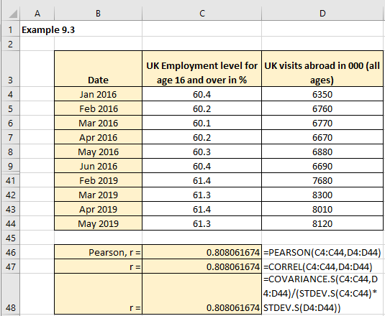
Excel solution
Figure 9.20 represents the Excel solution with rows 10 to 40 hidden.
Pearson’s correlation coefficient, r = 0.81
This value indicates a strong positive linear association between the value of the visits abroad (y) and the percentage of employed age 16 and over (x), confirming the impression from the scatter plot in Figures 9.6 and 9.10.

Slide 15
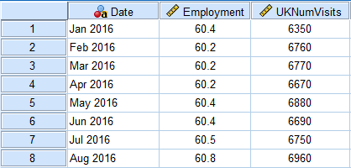
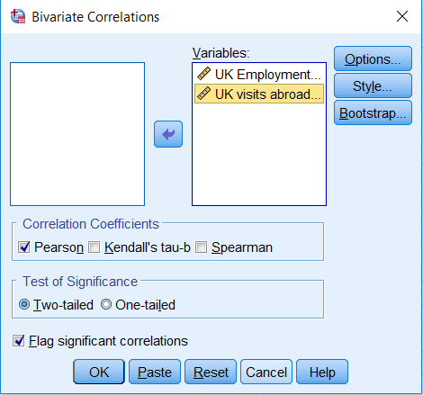
SPSS solution (1/2)
SPSS data file: Chapter 9 Linear correlation and autocorr.sav (only first 8 records illustrated below)
Analyze > Correlate > Bivariate
Transfer UK employment and UK visits abroad variables to the Variables box
Choose Pearson
Click OK

Slide 16
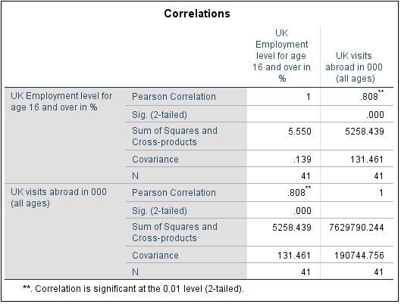
SPSS solution (2/2)
SPSS Output
The correlation itself is 0.81. This indicates a strong (positive) linear relationship between employed and number of visits. The p-value, denoted by “Sig. (2-tailed)”, is 0.000. This value of the p-value = 0.000 < 0.05, and we conclude that the correlation between the two variables is significant.
The results are based on N = 41 cases. Since this corresponds to our sample size, we conclude that there are no missing values in our data. A strong linear relationship was observed between the variable employed and the number of visits, Pearson correlation co-efficient r = 0.81, p-value = 0.000 (2-tailed).

Slide 17
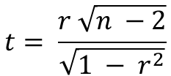
What is the SPSS Pearson correlation coefficient p-value and how to calculate in Excel
The p-value provided in SPSS tells us if the correlation co-efficient is significant – how do we calculate this in Excel?
Null Hypothesis: H₀: ρ = 0
Alternate Hypothesis: H₁: ρ ≠ 0
Test statistic
$$t= \frac{r \sqrt{n −2}}{\sqrt{1 − r^{2}}}$$
with df = n - 2
Null Hypothesis H₀:
There IS NOT a significant linear relationship(correlation) between x and y in the population.
Alternate Hypothesis H₁:
There IS A SIGNIFICANT LINEAR RELATIONSHIP (correlation) between x and y in the population.
Have r= 0.808…, n = 41
Gives t = 8.566222303…
Now use the Excel function T.DIST .2T(t, df) to give the 2-tailed p-value = 1.6905E-10, which is virtually zero.
SPSS solution:

Slide 18
The coefficient of determination, r² or R-Squared
What happens if we take the Pearson coefficient to the power of two, in other words r²? We get a new measure that is called the coefficient of determination. Most of the software packages refer to this statistic as R-squared or R-square. In our Example 9.3, the value of r=0.81. This means that R-squared, or r² = 0.81² = 0.65. How do we interpret this statistic and the corresponding value?
Unlike the coefficient of correlation whose range is between -1 (negative correlation), via 0 (no correlation), to +1 (positive correlation), R-squared goes only between 0 and 1. The meaning of 1 is that the changes in one variable are 100% accompanied by the changes in another variable. The meaning of 0 is that the two variables have no impact on one another.
The value of 0.65 for R-squared in the example above means that 65% of the movements in visits abroad in the UK can be explained by the changes in employment. The remaining 35% (100-65=35) of movements is attributed to some other factors beyond the employment rate.

Slide 19

Spearman’s rank correlation coefficient, r_{s} (1/3)
We’ll now cover an example for data collected in ranked form. In this case, a ranked correlation coefficient can be determined.
Equations (9.2 – 9.4) provide the value of Pearson’s correlation coefficient between two data variables x and y, which are both at an interval level of measurement. The question then arises what do we do if the data variables are both ranked? In this case we can show algebraically that equation (9.4) is equivalent to equation (9.5).
Equation (9.5) is known as Spearman’s rank correlation coefficient.
Where Xr = rank order value of X, Yr = rank order value of Y, and n = number of paired observations.

Slide 20
Spearman’s rank correlation coefficient, r_{s} (2/3)
The use of ranks allows us to measure correlation using characteristics that cannot be expressed quantitatively but can be ranked. This equivalence between equations (9.4) and (9.5) will only be true for situations where no tied ranks exist.
When tied ranks exist then you will find discrepancies between the value of r and r_{s}.
As with the other nonparametric tests introduced in this textbook, ties are handled by giving each tied value the mean of the rank positions for which it is tied.
The interpretation of rs is like that for r, namely:
(a) A value of rs near 1.0 indicates a strong positive relationship, and
(b) A value of rs near - 1.0 indicates a strong negative relationship.

Slide 21
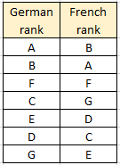
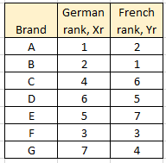
Spearman’s rank correlation coefficient, r_{s} (3/3)
Example 9.4
A company makes seven different brands (A, B, …, G) and they are sold to two export markets, Germany and France. The brands are ranked differently in each market. You are asked to decide whether the brand rank in Germany correlates with the rank for seven brands in France. The data is provided in Table 9.3. Since the information is ranked, we use Spearman's correlation coefficient to measure the correlation between German and French ranks.
or

Slide 22
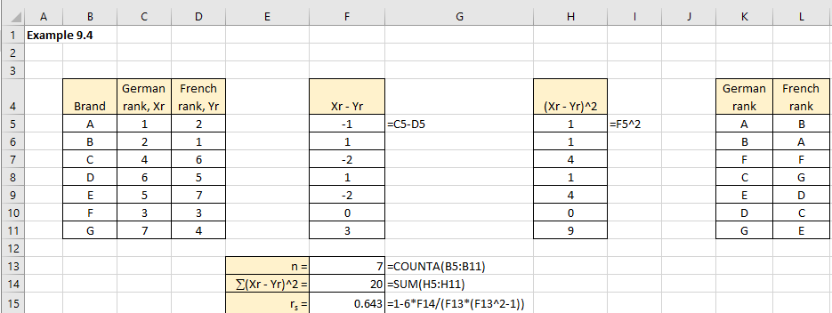
Excel solution (1/3)
Excel does not offer a built in Spearman rank correlation coefficient, so we will use Excel to conduct manual calculations. Figure 9.25 shows these calculations.
Spearman rank correlation is positive
r_{s} = 0.643
indicating that there is a reasonably high positive rank correlation in this case.
The way our brands A to G are ranked in German and French market indicates medium correlation. This implies that these two markets, as far as the ranking of our brands are concerned, are not very strongly correlated.

Slide 23
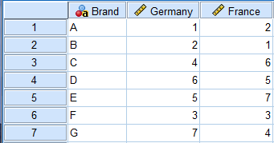
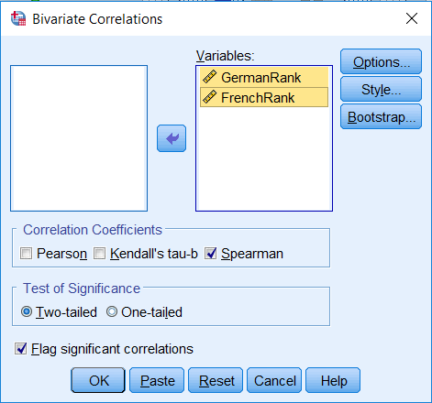
SPSS solution(2/3)
Analyze > Correlate > Bivariate
Transfer German Rank and French Rank variables to the Variables box
Click on Spearman
Click OK

Slide 24
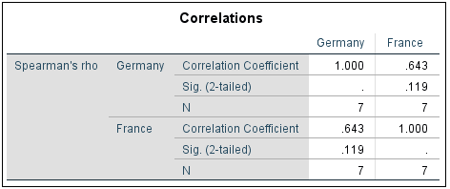
SPSS solution(3/3)
SPSS Output
Spearman’s correlation coefficient is 0.643.
This indicates a medium (positive) linear relationship between the French and German ranks.
The p-value, denoted by “Sig. (2-tailed)”, is 0.119. This value of the p-value = 0.119 > 0.05, and we conclude that the correlation between the two variables is not significant. The results are based on N = 7 cases. Since this corresponds to our sample size, we conclude that there are no missing values in our data.

Slide 25
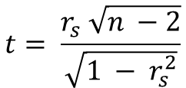
What is the SPSS Spearman correlation coefficient p-value and how to calculate in Excel
The p-value provided in SPSS tells us if the correlation co-efficient is significant – how do we calculate this in Excel?
Null Hypothesis: H₀: ρ = 0
Alternate Hypothesis: H₁: ρ ≠ 0
Test statistic
$$t= \frac{r_{s} \sqrt{n −2}}{\sqrt{1 − r_{s}^{2}}}$$
with df = n - 2
Null Hypothesis H₀:
There IS NOT a significant linear relationship(correlation) between x and y in the population.
Alternate Hypothesis H₁:
There IS A SIGNIFICANT LINEAR RELATIONSHIP (correlation) between x and y in the population.
Have r = 0.643.…, n = 7
Gives t = 1.877340656 ……
Now use the Excel function T.DIST .2T(t, df) to give the 2-tailed p-value = 0.11928
SPSS solution:

Slide 26
Introduction to linear regression
Linear regression analysis is one of the most widely used techniques for modelling a linear relationship between variables. It is employed in a wide range of subjects (business, economics, psychology, social sciences in general). Towards the end of this section we will extend the linear case to briefly mention non-linear and multiple regression modelling. It is important to realize that regression analysis can be used on all types of data:
temporal or time series data (monthly sales values, for example).
categorical or nominal data (example is the gender of the respondent).
ordinal data (example is ordering respondents into low economic status, medium and high economic status).
interval data (example are equally spaced categories, such as earnings below 20K, between 20-40K and 40-60K).

Slide 27


Linear regression (1/3)
Linear regression analysis attempts to model the relationship between two variables in the form of a straight-line relationship as given by equation (9.6)
$$Y=β_{0}+β_{1}X$$
Where, Y is the value of the dependent variable at given values of the independent variable (X) and β₀ and β₁ are the parameters that define this relationship.
The above equation (9.6) applies only if we have data for the whole population. For just the sample, the relationship is defined by equation (9.7).
$$\hat{y}=b_{0}+b_{1}x$$
The values of constants b₀ and b₁ are effectively estimates of some true values of β₀ and β₁ and ŷ is the estimate value for true Y.

Slide 28
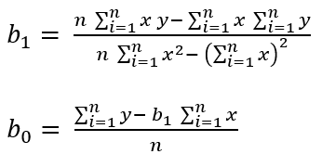

Linear regression (2/3)
The values of the two co-efficients b₀ and b₁ are calculated using the following equations:

Slide 29
Linear regression (3/3)
Regardless of what option is used, or if we do it manually, the process of going through regression analysis can be split into a series of steps:
Construct scatter plot to identify model.
Fit model to sample data.
Test model reliability (using the coefficient of determination, for example).
More advanced analysis, includes:
Test whether the predictor variables are significant contributors (undertake a t-test).
Test whether the overall model is a significant contributor (undertake an F-test if you have more than one independent variable).
Construct a confidence interval for the population slope, β₁.
Check model assumptions.

Slide 30
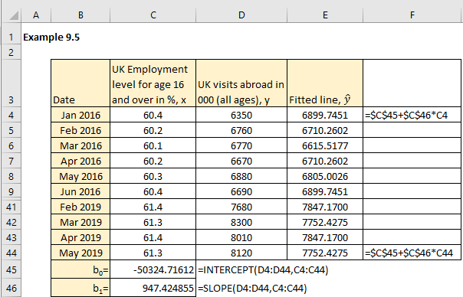
Fit line to scatter plot – Excel (1/3)
Example 9.5
We will use the same data sets as in Example 9.1. We will use built in Excel functions for the intercept and slope to calculate the fitted line, as per equations (9.8) and (9.9), that will go through the data points on a scatter diagram.
Figure 9.32 represents the Excel solution to fitting a line to the Example 9.5 data set (note that rows 10-40 are hidden).

Slide 31
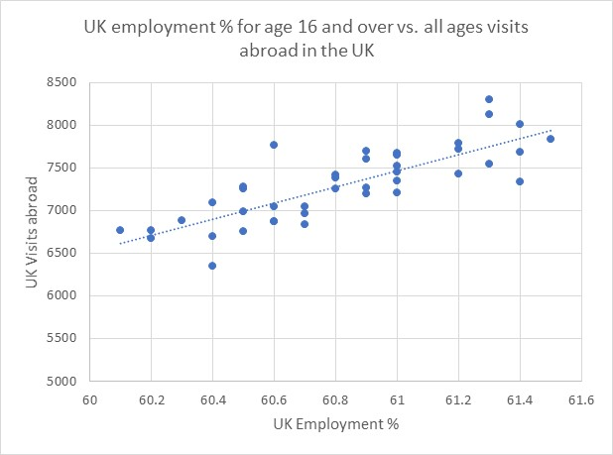
Fit line to scatter plot – Excel (2/3)
From Excel: b₀ = -50324.72 and b₁ = 947.42.
The above equation tells us that the number of UK visits abroad can be predicted from the percentage of employed in the UK for the ages of 16 and over as:
Number of visits abroad = (947.42 × Percentage employed) – 50342.72
The calculated regression line has been fitted to the scatter plot as shown in Figure 9.33.
Observe that most of the data points do not reside on the fitted line, which is to be expected. Nevertheless, the line seems to approximate the direction that these two variables are taking.

Slide 32
Fit line to scatter plot – Excel (3/3)
Since not all the points lie on the fitted line, we call this a model error (sometimes called residuals or variations) between the data y value and the value of the line at each data point ŷ (which is an estimate). This concept of error can be measured using a variety of methods, including:
coefficient of determination (COD, or R²).
standard error of estimate (SEE).
a range of inference measures to assess the suitability of the regression model fit to the data set.
An alternative approach to calculating the regression line in Excel is just to right-click on one of the data points in the graph and select Add Trendline option from the box

Slide 33
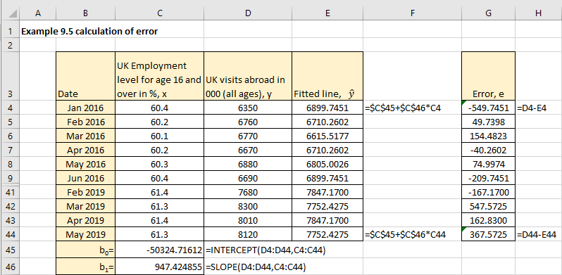

Residuals – Excel
As we already pointed out, there is obviously a degree of error between observed values of y and those estimated by the regression line (ŷ). These errors, or the differences, are also called the residuals and are defined by equation (9.10).

Slide 34
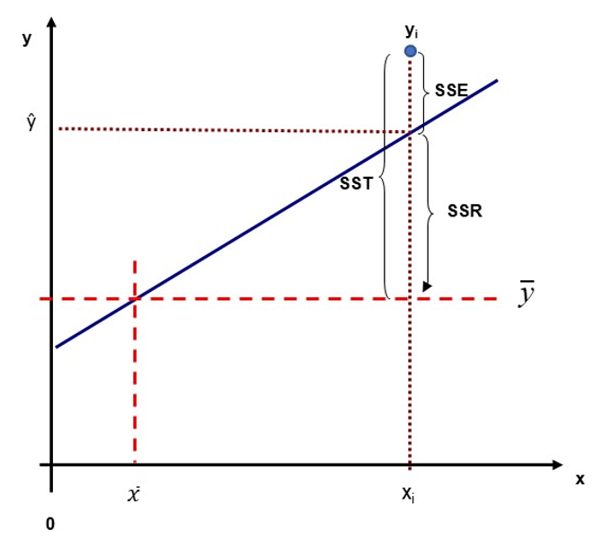
Sum of squares defined (1/2)
When conducting regression analysis, it is important to be able to identify three important measures of variation: regression sum of squares (SSR), error sum of squares (SSE), and total sum of squares (SST).
Figure 9.38 illustrates the relationship between these different measures.
For the sake of clarity, we are showing only one point y_{i}.
SST = SSR + SSE

Slide 35



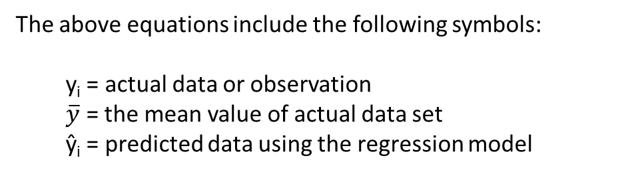
Sum of squares defined (2/2)
Regression sum of squares (SSR) – sometimes called explained variations is defined as:
Regression error sum of squares (SSE) – sometimes called unexplained variations is defined as:
Regression total sum of squares (SST) – sometimes called the total variation is defined as:
The above equations include the following symbols:
y_{i} = actual data or observation
$\overline{y}$ = the mean value of actual data set
ŷ_{i} = predicted data using the regression model
SST = SSR + SSE

Slide 36

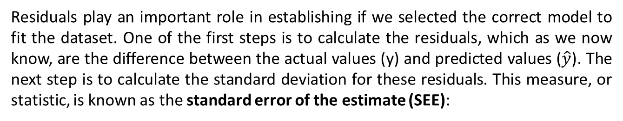
Test how well the model fits the data (1/2)
Of the many methods used to assess how good is the regression line (or the model) we shall discuss: (a) Residuals and the Standard Error of the Estimate (SEE), and (b) Coefficient of Determination (COD), or R-squared. These two methods measure two completely different properties of the model.
Standard Error of the Estimate
Residuals play an important role in establishing if we selected the correct model to fit the dataset. One of the first steps is to calculate the residuals, which as we now know, are the difference between the actual values (y) and predicted values ($\hat{y}$). The next step is to calculate the standard deviation for these residuals. This measure, or statistic, is known as the standard error of the estimate (SEE):
When comparing different regression models we want this to be as small as possible compared to the other model(s).

Slide 37
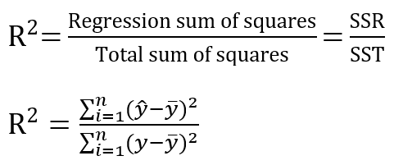
Test how well the model fits the data (2/2)
Coefficient of Determination or R-squared
As opposed to the SEE that measures how “close” are the estimated values from the actual values, the coefficient of determination (COD) has a different purpose.
Given that the regression line effectively summarises the relationship between x and y, then the line will only partially explain the variability of the observed values. The total variability of y can be split into two components:
variability explained or accounted for by the regression line.
unexplained variability as indicated by the residuals.
COD = (Correlation Coefficient)² = R² (or r²)
When comparing different regression models we want this to be closer to 100% compared to the other model (s).

Slide 38
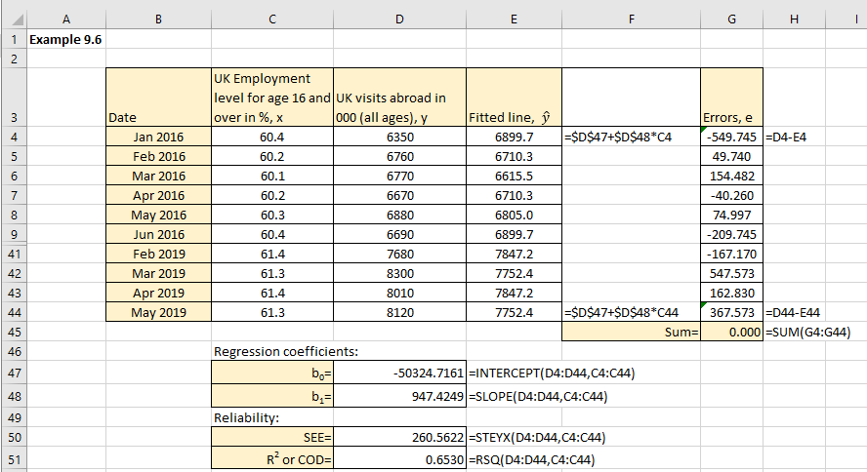
Example 9.6 - Excel solution
Re-consider the Example 9.1 data set and test the linear regression model reliability. Figure 9.42 illustrates the Excel solution to calculate the coefficient of determination and the standard error of the estimate (again rows 10-40 are hidden in this Figure).

Slide 39
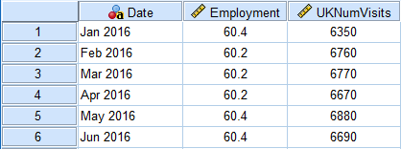
Example 9.6 – SPSS solution (1/7)
Input data into SPSS
(Only the first 6 rows of data are shown)

Slide 40
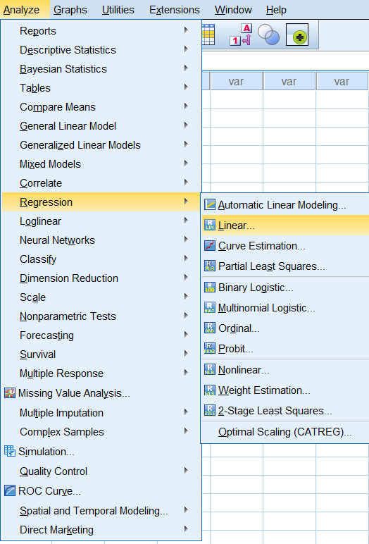
Example 9.6 – SPSS solution (2/7)
Analyze > Regression > Linear

Slide 41
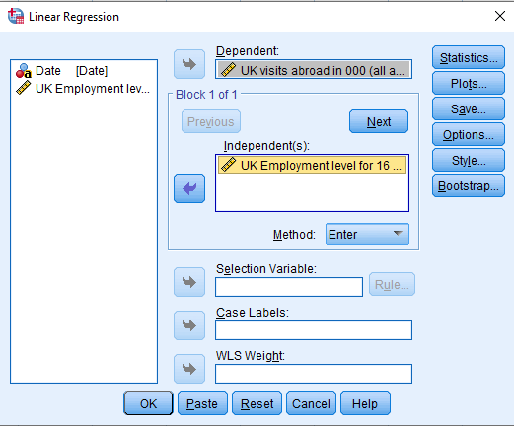
Example 9.6 – SPSS solution (3/7)
Transfer UK visits to the Dependent box
Transfer UK Employment to the Independent(s) box
Method option selected is Enter
Note:
Click on Plots if you want to undertake assumption testing

Slide 42
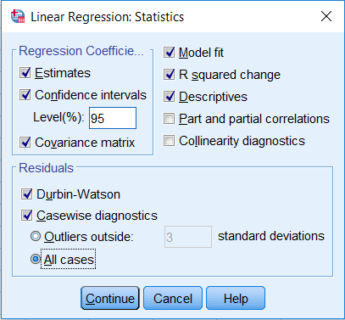
Example 9.6 – SPSS solution (4/7)
Click on Statistics
Tick the boxes as shown
Click Continue
Click OK

Slide 43
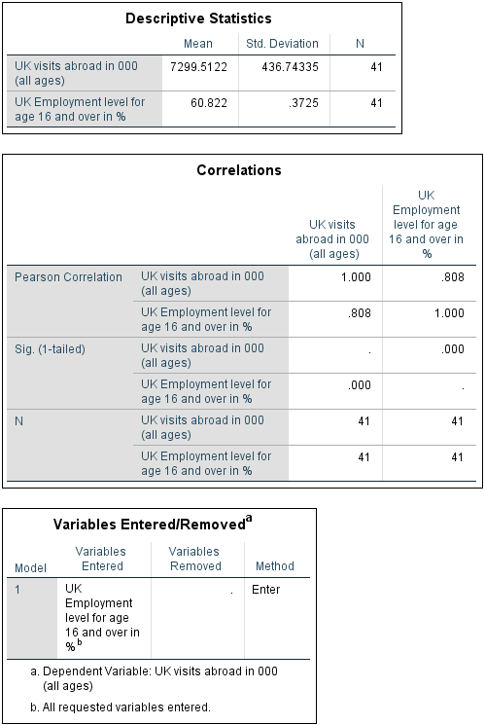
Example 9.6 – SPSS solution (5/7)
SPSS Output

Slide 44
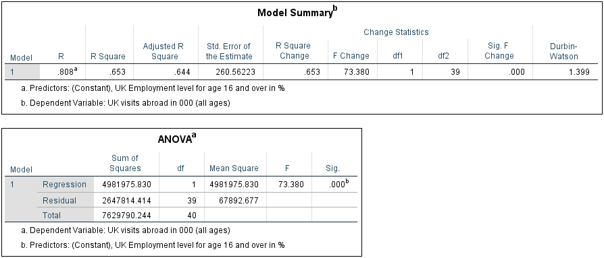
Example 9.6 – SPSS solution (6/7)

Slide 45
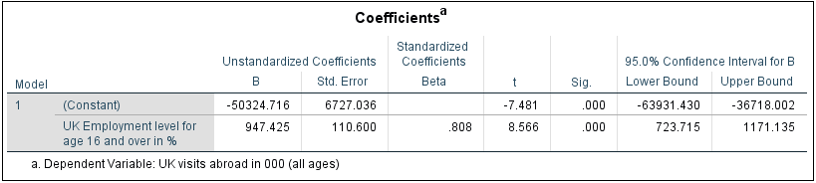
Example 9.6 – SPSS solution (7/7)

Slide 46
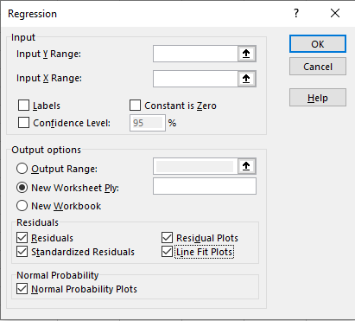
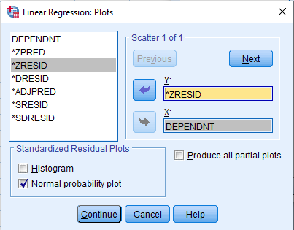
Regression assumptions using Excel and SPSS
Excel:
Use Data > Data Analysis > Regression
SPSS:
Analyze > Regression > Linear
Click on Plots

Slide 47
Regression assumptions (1/5)
The four assumptions of regression are:
Linearity
Independence of errors
Normality of errors
Constant variance.
1. Linearity assumption
Linearity assumes that the relationship between the two variables is linear. To assess linearity, the residuals (or errors) are plotted against the independent variable, x. In Excel if you go to Data > Data Analysis > Regression, you will automatically get this plot if requested. From Figure 9.39 we observe that there is no apparent pattern between the residuals and x. Furthermore, the residuals are evenly spread out about error equal to zero.

Slide 48
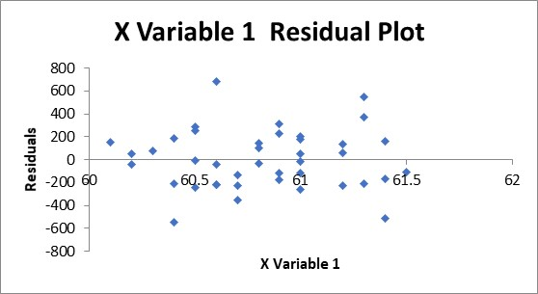
Regression assumptions (2/5)
Excel solution only
In this example, because the errors are randomly spread, the conclusion is that a line fit to the dataset would appear appropriate. If the scatter plot suggests that the relationship is non-linear (i.e. there is some pattern), then you would have to identify it and fit this non-linear relationship to your data set.

Slide 49
Regression assumptions (3/5)
2. Independence assumption
The regression independence of errors assumption can be a problem if the data values are not independent of the previous data values measured. This effect is called serial correlation and can be measured using the Durbin-Watson statistic. Another expression for serial correlation, though usually used in a different context, is autocorrelation. Both autocorrelation and the Durbin-Watson statistic are covered online.
3. Normality of errors assumption
The normality of errors assumption requires that the measured errors (or residuals) are normally distributed for each value of the independent variable, x. If this assumption is violated then the result can produce unrealistic estimates for the regression coefficients b₀, b₁, and the measures of correlation. Also, any inference tests or confidence intervals calculated are dependent upon the errors being normally distributed. This assumption can be evaluated using graphical methods.

Slide 50
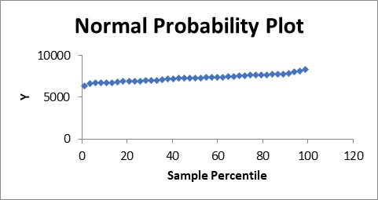
Regression assumptions (4/5)
Excel solution only
Figure 9.62 illustrates a normal probability plot based upon the Example 9.1 data set.
For a plot to confirm the normality of errors, it must follow an approximately straight line, i.e. it cannot be non-linear or “jump” too much up and down.
We observe From Figure 9.62 that the relationship is linear, and we conclude that the normality assumption is not violated. This problem can occur if the dependent and/or independent variables are not normally distributed, or the linearity assumption is violated.

Slide 51
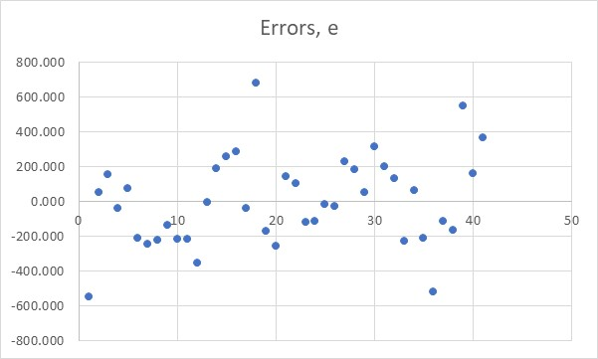
Regression assumptions (5/5)
4. Constant variance assumption
The final assumption of regression equal variance assumption (or homoscedasticity) requires that the variance of the errors is constant for all values of x. This implies that the variability of the y values is the same for all values of x. This assumption is important when making inferences about β₀ and β₁.
Excel solution only
This plot shows that the variance assumption is not violated.
If the value of error changes greatly as the value of x changes then we would assume that the variance assumption is violated.

Slide 52
Conclusion
In this presentation we explored the fitting a least squares regression line to a bivariate data set:
Linear Correlation Analysis
Linear Regression Analysis

